Slide 1
THE NORTH RIDGEVILLE CHURCH OF CHRIST
Scripture taken from the New King James Version®.
Copyright © 1982 by Thomas Nelson. Used by permission. All rights reserved.

Slide 2
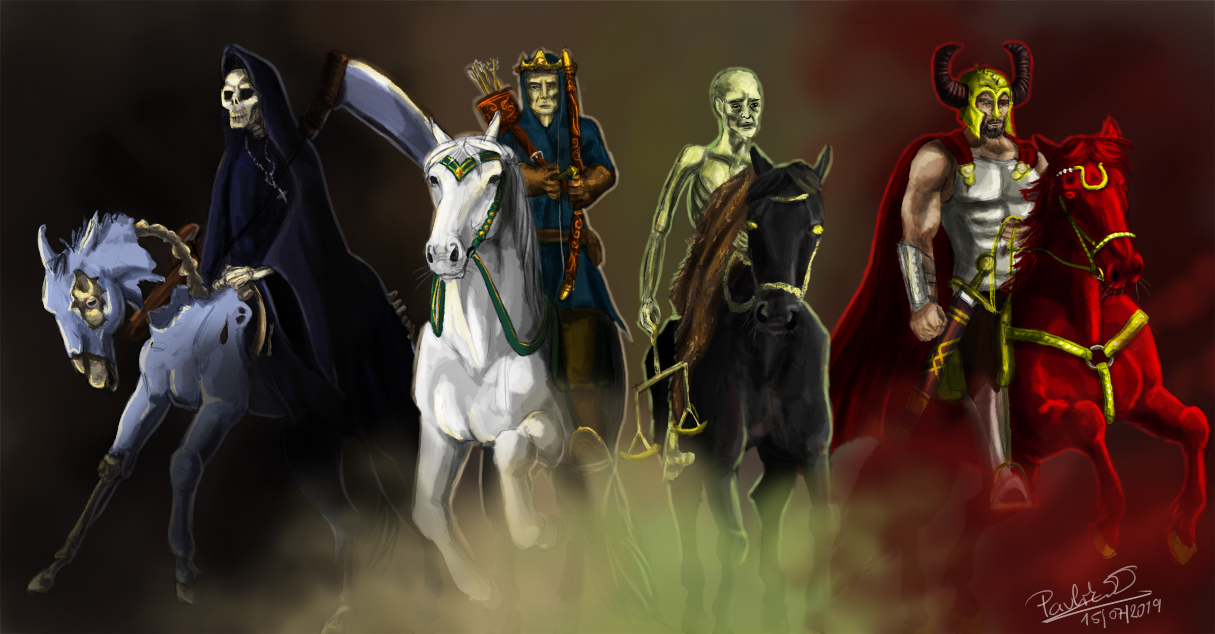
THE FOUR HORSEMEN
REVELATION 6:1-8
This Photo is licensed under CC BY-NC

Slide 3
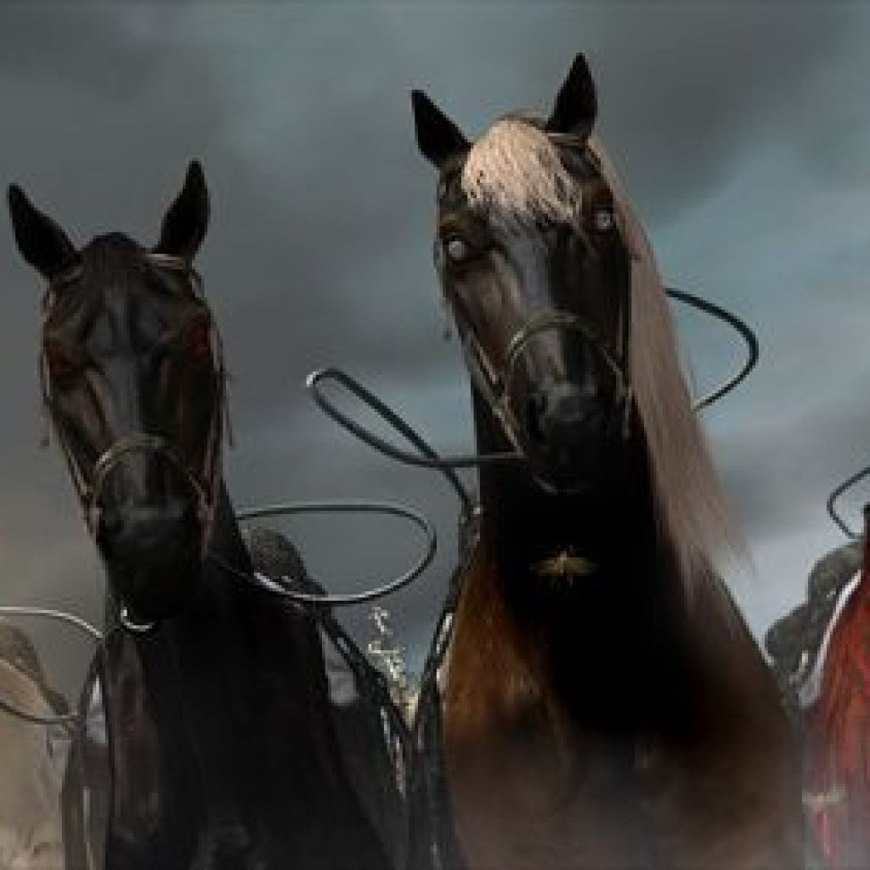
WAR!
Job 39:19-25
Jeremiah 6:23; 12:5; 46:4; etc.
Similar images: Zech. 1:7-11; 6:1-8
This Photo by Unknown Author is licensed under CC BY-SA-NC

Slide 4
Why Four Horsemen in the Opening Seals?
The symbol “FOUR” = EARTH (7:1; Zech. 6:1-8)
All part of the same unit to convey the difficulty of the time

Slide 5
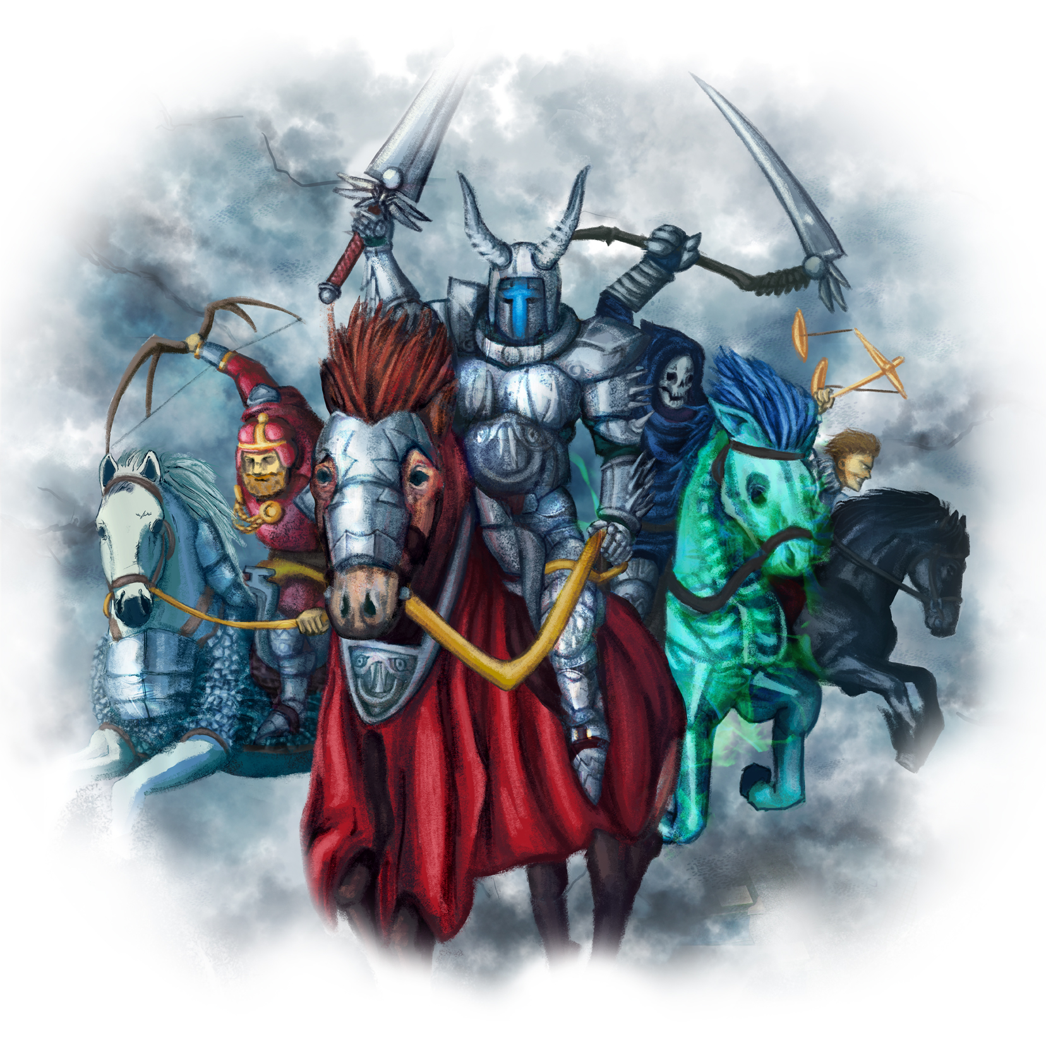
First Horseman
Rev. 6:2 | Rev. 19:11-16
One Crown | Many Crowns
“stephanos” | “diadēma”
Bow | Sword
Not Identified | Identified
This Photo by Unknown Author is licensed under CC BY-NC-ND

Slide 6
Second Horseman
Revelation 6:3, 4
Fiery Red
Purpose: to take away peace
A great sword
This Photo by Unknown Author is licensed under CC BY-NC-ND

Slide 7
Third Horseman
Revelation 6:5, 6
Black horse
Pair of scales
Economic hardship
This Photo by Unknown Author is licensed under CC BY-NC-ND

Slide 8
Fourth Horseman
Revelation 6:7, 8
Pale (green) horse
Where death (Thanatos) rides, Hades follows
Power to kill a fourth of the earth
This Photo by Unknown Author is licensed under CC BY-NC-ND

Slide 9
What Do These Four Horsemen Teach Us?
TROUBLE runs through the world
TROUBLE runs over saints
TROUBLE further ruins sinners
TROUBLE is limited by God

Slide 10
Then one of the elders answered, saying to me, "Who are these arrayed in white robes, and where did they come from?"
And I said to him, "Sir, you know." So he said to me, "These are the ones who come out of the great tribulation, and washed their robes and made them white in the blood of the Lamb.
Revelation 7:13, 14

Slide 11
The sea gave up the dead who were in it, and Death and Hades delivered up the dead who were in them. And they were judged, each one according to his works.
Then Death and Hades were cast into the lake of fire. This is the second death.
Revelation 20:13, 14

Slide 12
And I heard a loud voice from heaven saying, "Behold, the tabernacle of God [is] with men, and He will dwell with them, and they shall be His people. God Himself will be with them [and be] their God.
"And God will wipe away every tear from their eyes; there shall be no more death, nor sorrow, nor crying. There shall be no more pain, for the former things have passed away."
Revelation 21:3, 4

